Slide 1

CapacityBay C++ COURSE DANIEL EMEKA - ILOZOR

Slide 2
#2 Hello World

Slide 3
TABLE of contents
Definition of Concepts
Setting Up Code::Blocks
Creating a Project
The Layout
Hello World Explained

Slide 4
01 Definition of CONCEPTS

Slide 5
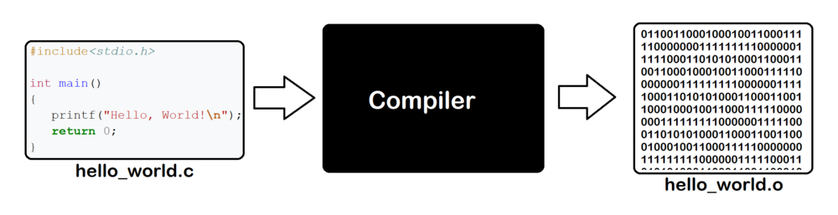
compiler
A compiler is like a translator for computers. It takes the code that humans write and turns it into instructions that computers can understand and follow.

Slide 6


CODE Editor
A code editor is a software tool that allows programmers to write and edit their code. It provides essential features like syntax highlighting, auto-completion, and indentation to help streamline the coding process. Unlike an IDE, a code editor focuses solely on code editing without additional development tools like debugging or project management.

Slide 7




IDE
An Integrated Development Environment (IDE) is a software tool that helps programmers write, edit, and organize code more efficiently by providing features like code editing, debugging, and project management all in one place

Slide 8
02 Setting Up Code::Blocks

Slide 9


CHOOSING THE IDE/CODE EDITOR
Code::Blocks <- We will use this
Sublime Text
Visual Studio/VS Code
Eclipse CDT
Xcode (for macOS)
Clion
Geany
Vim
Online Editors: ideone, shell, GDB
…

Slide 10
Installing a C++ Compiler
Some IDEs like Code::Blocks come with a mingw C++ compiler, but for some other IDES, you’d need to download:
Windows: MinGW or Visual C++
macOS: Xcode command-line tools
Linux: GCC or Clang
Research more on this if you will not be using code::blocks
After downloading the compiler, you would need to set the compiler to the one you downloaded in your respective IDE settings.

Slide 11
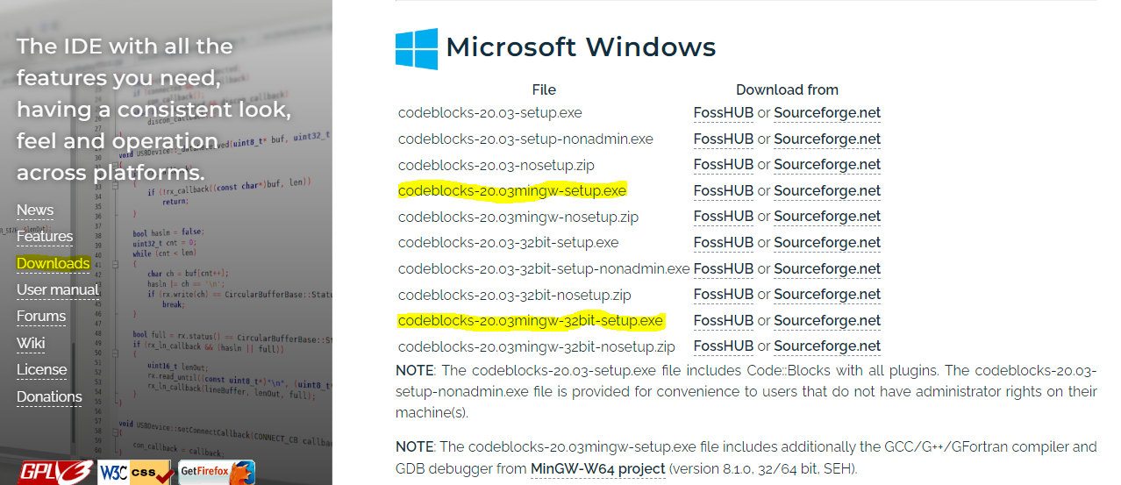
Downloading Code::Blocks
On a search engine, search for “code::blocks” and click the first link you see. Go to Downloads by the side, pick one of the highlighted setups depending on your computer(32 bit or 64 bit).

Slide 12
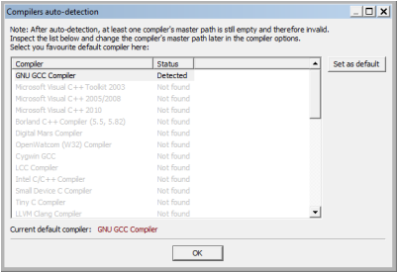
Opening Code::Blocks
The first time it is opened C::B will search for compilers it can use. A dialog that looks like this will open. Select GCC if there are multiple options:

Slide 13
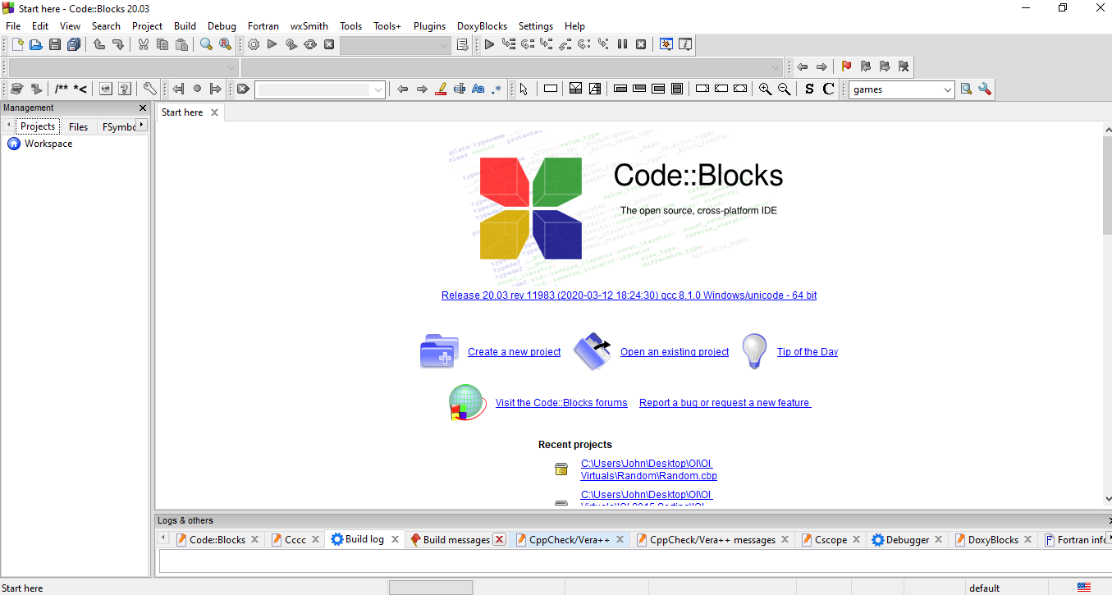
Opening Code::Blocks
Now, you’re set! This should be the start-up screen you encounter when opening Code::Blocks

Slide 14
03 Creating a Project

Slide 15
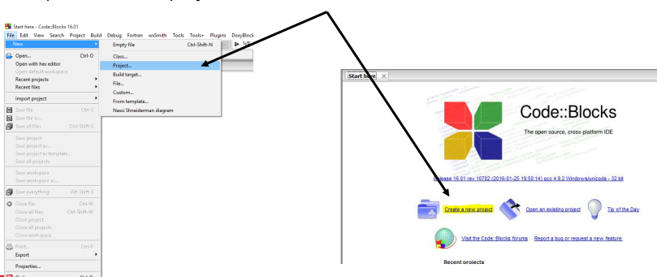
Creating a Project
Once Code::Blocks is set, you’ll find this start menu screen. From there, you can create a new project or open an already existing one. At the top left of the screen, you’ll find file tab, then follow below picture to create a new project

Slide 16
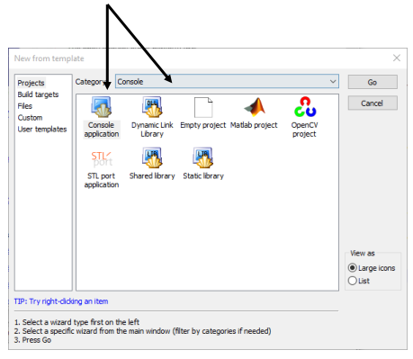
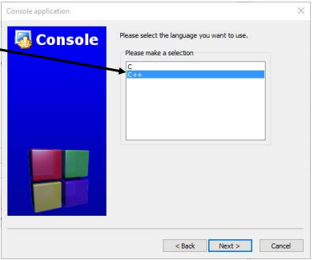
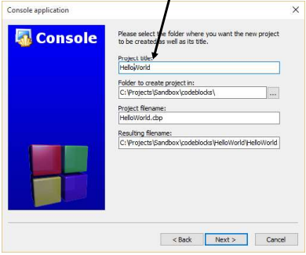
Creating a Project
Choose the Console Category and then console application, then click Go.
Click Next on the “Welcome to the new console application wizard!” screen. Choose C++ …then click Next.
Name your file, and pick the appropriate location to store your C++ projects. It’s recommended to store them in a separate folder.

Slide 17
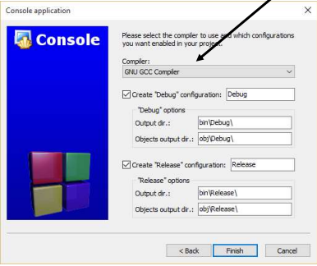
CREATING A PROJECT
Choose the compiler.
Choose GNU GCC as the compiler.
Leave the rest as defaults
Click Next

Slide 18
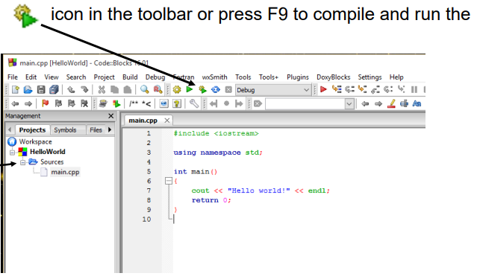
CREATING A PROJECT
To confirm everything has been set up correctly, click the icon as shown below, or F9 key, to compile and run the program. You should see a terminal open up and the following phrase:
“Hello world!”
You have now made your first C++ project

Slide 19
04 The Layout

Slide 20
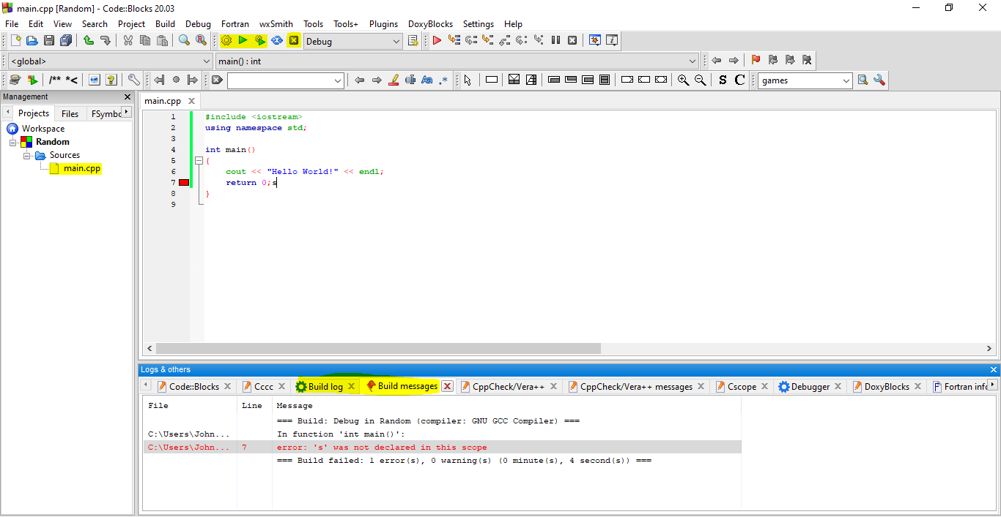
The Layout
There are many buttons used for various functions available on C::B. The most important ones for now are highlighted as yellow in this picture.

Slide 21
BUILD/RUN/ABORT
In C++, a file has to be built(or compiled) first before you can see it’s output(and must be done so after each change to it).
To check the output, we must run the file.
To terminate the program during run-time, we then abort.
The 1st icon(gear icon) -> building the file
The 2nd icon(triangle icon) -> run the file
The 3rd icon - > build the file THEN run it
The 5th icon -> Abort the program
Notice the abort icon is greyed out before running a program.
Before run
During run

Slide 22
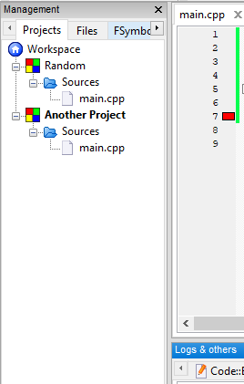
MANAGEMENT
Under the Management window, we have a few tabs. The important one is Projects tab. This tab keeps track of all projects we have open in the current window.
The current project that is open will be bolded. Notice that “Another Project” is bolded. This is project that will run if we hit the build/run buttons.
Each project is a collection of files which will be shown under here too.

Slide 23
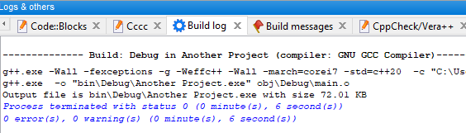
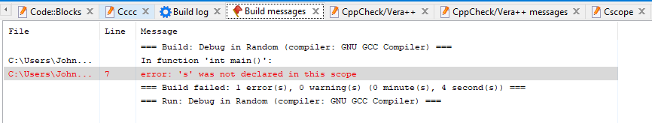
BUILD LOG/MESSAGE
Build log shows us information like number of errors/warnings encountered when attempting to run the program.
Build message shows us information like the lines the errors actually occurred. This is very useful for fixing errors in code.

Slide 24
05 Hello World Explained

Slide 25
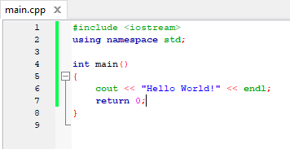
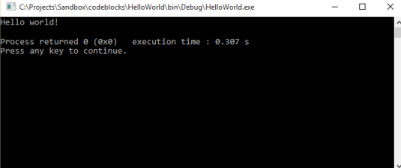
HELLO WORLD!

Slide 26
HEADER FILES
C++ uses header files as to hold definitions for the compiler to use while compiling.
In this case, the “iostream” header file which is known as “input output stream” is needed before you can use the “cout” keyword to print Hello World to output. They always start with #include

Slide 27
NAMESPACE
C++ namespaces are like containers that group related code together, preventing naming conflicts and improving code organization. There are in-built namespaces in C++. This one is called std namespace which is actually short for “standard namespace”. We need this to call the cout keyword which is from the standard c++ namespace. Without this line, we would have to use cout by typing “std::cout” every time
To use a namespace, we type “using namespace ‘name’ ”

Slide 28

MAIN()
The main() function in C++ is the starting point of a program. When a C++ program is run, the computer looks for the main function and executes the code inside it.
If you notice, the main() function has an “int” before it. It is always accompanied with () and immediately with a {} for which the main code is to be placed inside.
This is important.

Slide 29
Cout, <<, endl
Cout: This is a C++ command used to display text or values on the screen.
<< : This is used with cout to display the values. The direction of those angular brackets is important.
“Hello World!”: This is the text to be displayed. The quotation marks “” tell the compiler that the text inside is just a text and not a command to be executed.
Endl: This means end line. It basically stops printing at the current line and moves to the next line of the console(terminal). It’s like an Enter key when typing a word document.

Slide 30

RETURN
This means we are done running the function so we should return from the main function. Return 0 is basically the same as saying “return that there are 0 bugs in the program”
If the program in the console does not show “Process returned 0”, it probably means there was an error in your program
The main function automatically returns 0 if this line is absent

Slide 31
The SEMICOLON ;
You must have noticed by now that some lines have a semicolon at the end of them. It’s similar to a full-stop in english, which signifies that the current sentence has ended and we are moving to a new one. In this case, it means the current statement/command has ended are we are moving to a new one. This makes sure the compiler knows when a command has ended or not. It is important to always put this after a statement.

Slide 32
THANKS Q/A

